Slide 1
PRESENTATION ON
CURRENCY CONVERTER

Slide 2
WHAT IS A CURRENCY CONVERTER
It’s a program where currency values can be easily converted based on current exchange rates. These currency converters can quickly convert the value of one currency to another without you having to convert it manually using calculators or other means.

Slide 3
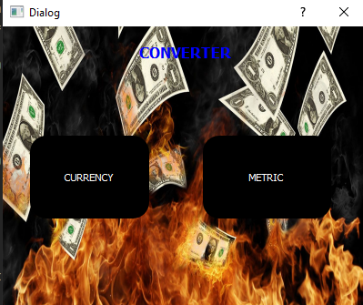
CONVERTER PAGE
As y’all can see this is the page in which you select what you want to convert, If it’s currency or metric

Slide 4
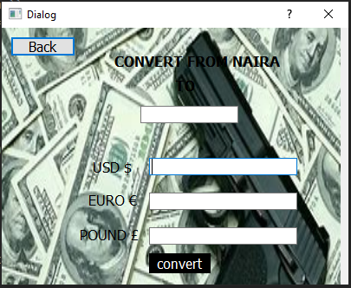
CURRENCY PAGE
This is the page in which you’ll convert from NAIRA to USD,EURO or POUND

Slide 5
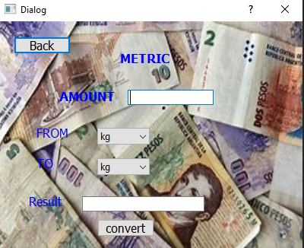
METRIC PAGE
This is the metric page in which you can be able to convert from kg to gram and from km to meter

Slide 6
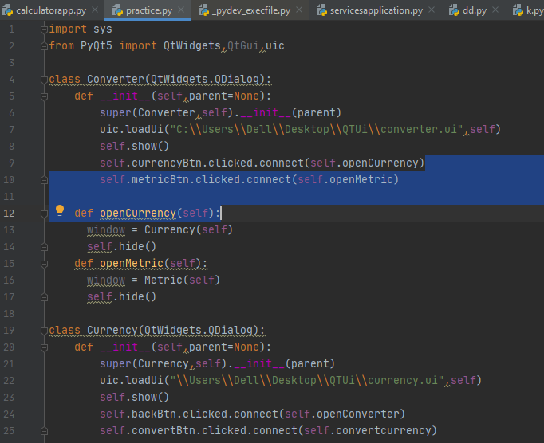

Slide 7
